Slide 1
Minnesota Paid Leave
February 12, 2025

Slide 2
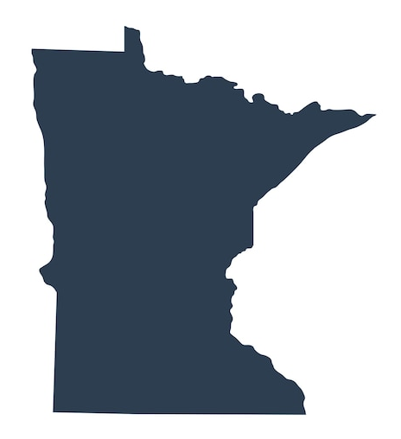
Why Paid Leave Matters
Minnesotans take care of each other. In our communities, families, and workplaces, we step up and help the people we care about.
Minnesota Paid Leave will support people when they need time to care for themselves and their loved ones.
Supporting your employees when they need time for leave builds connections in our families, communities, and workplaces, and improves employee retention, performance and morale on the job.
Minnesota Paid Leave will help ensure Minnesotans don't need to choose between financial stability and being there for their families.

Slide 3
Minnesota’s Paid Leave Program
The Minnesota Paid Leave law, enacted in May 2023 and updated in May 2024, makes paid family and medical leave coverage available to Minnesota workers beginning Jan. 1, 2026.
The law provides job protections and partial wage replacement, paid by the state, to individuals who take leave for a qualifying condition, such as to bond with a new child or for medical care for themselves and their loved ones.
The Paid Leave program will be funded by premiums made up of contributions from employees and employers.

Slide 4
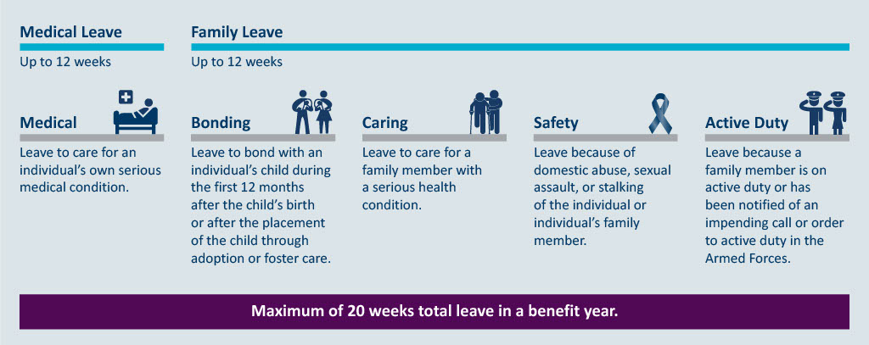
Covered Leave
Medical Leave: Up to 12 Weeks
Medical: Leave to care for an individual’s own serious medical condition
Family Leave: Up to 12 weeks
Bonding: Leave to bond with an individual’s child during the first 12 months after the child’s birth or after the placement of the child through adoption or foster care.
Caring: Leave to care for a family member with a serious health condition.
Safety: Leave because of domestic abuse, sexual assault, or stalking of the individual or individual’s family member.
Active Duty: Leave because a family member is on active duty or has been notified of an impending call or order to active duty in the Armed Forces.
Maximum of 20 weeks total leave in a benefit year.
Qualifying conditions must last more than seven days and be certified by a health care provider or designated professional.
Notes:
Qualifying conditions must last more than seven days, and a health care provider or designated professional must certify the need for leave and the amount of time.
A person may take up to 12 weeks for Medical leave: for their own mental or physical illness, treatment or preventive care
A person can take up to 12 weeks of Family leave for covered events:
Bonding/parental leave: bond with a new child after birth, foster or adoption
Safety Leave: domestic assault, sexual abuse or stalking
Caring Leave: family member’s mental or physical illness, treatment or preventive care
Active Duty Leave: family member on active duty or notified of impending order
In a single benefit year, an individual can take a maximum total of 20 weeks of combined medical and family leave.
Across all these covered events, a health care provider or designated professional must certify the need for leave and the amount of time off required.

Slide 5
Covered Employees
Not covered, can opt in:
Independent contractors
Self-employed individuals
Tribal Nations
Not covered, can’t opt in:
Federal government employees
Exempt seasonal employees
Railroad employees
Covered employees include:
Covered employees include:
Full-time, part-time workers
Most seasonal employees
Owner-officers who draw a salary
Agricultural workers
Employees of religious organizations
Temporary workers
Student workers
Employed family members
First responders
Elected and appointed officials
Full-time, part-time workers
Most seasonal employees
Owner-officers who draw a salary
Agricultural workers
Employees of religious organizations
Temporary workers
Student workers
Employed family members
First responders
Elected and appointed officials
Not covered, can opt in:
Not covered, can’t opt in:
Independent contractors
Self-employed individuals
Tribal Nations
Federal government employees
Exempt seasonal employees
Railroad employees
Notes:
This is a great slide. Let’s document a definition for each, and also document where inclusion is different in other programs (UI, ESST, etc.)

Slide 6
Minnesota Employees
Paid Leave covers Minnesota employees. The Paid Leave law defines Minnesota employees as:
Employees who worked 50 percent or more of the prior year in Minnesota, or
For employees who did not work 50 percent or more of the year in any one state, those who live in Minnesota.
Scenarios:
I have employees who work mostly in Wisconsin, are they covered?
I have employees who exclusively work remotely from Wisconsin, are they covered?
My business is in North Dakota, but some of the people I hire live in Minnesota - are they covered?
I’m a traveling salesman and do work across the entire Midwest, am I covered?
Scenarios
I have employees who work mostly in Wisconsin, are they covered?
I have employees who exclusively work remotely from Wisconsin, are they covered?
My business is in North Dakota, but some of the people I hire live in Minnesota - are they covered?
I’m a traveling salesman and do work across the entire Midwest, am I covered?

Slide 7
Paid Leave Wage Payments
Paid Leave helps Minnesotans focus on what matters, whether that's caring for a child, recovering from an illness, or supporting a loved one.
Minnesotans can get up to 90% of usual wages, up to a maximum of $1,372 per week (based on 2024 numbers).
Lower-wage workers get more support. If you earn less, you'll get a higher percentage of your paycheck covered while on leave.
You must have earned at least 5.3% of the statewide average yearly wage in the past year to be eligible ($3,781 in 2024).

Slide 8
Paid Leave Job Protection
Job protected leave improves employee retention, as workers can take the time they need to bond and care without having to choose between their job and their family.
An employee who has taken family or medical leave must be restored to the same position or an equivalent position with the same pay, status, benefits, length of service, and seniority as prior to the date of leave.
Job protections for employees begin after 90 calendar days from the date of hire.

Slide 9
Building Minnesota Paid Leave
Partnering for Paid Leave that works for all

Slide 10
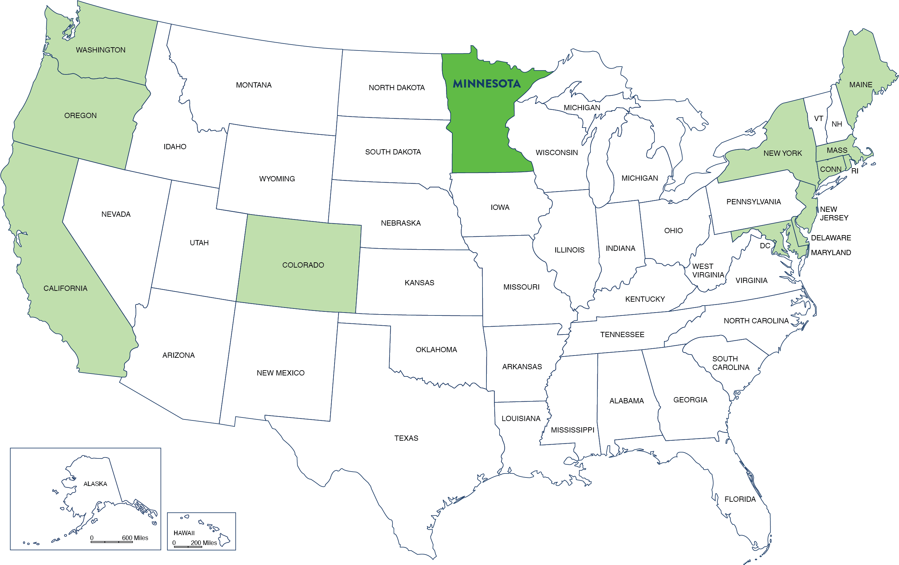
Building Paid Leave
Minnesota will be the 13th state to implement Paid Leave, and we will leverage other states' experiences to build an intuitive, accessible program that works.
US map highlighting states with paid leave programs (Washington, Oregon, California, Colorado, Maine, Massachusetts, Rhode Island, Connecticut, New York, New Jersey, Delaware, Maryland, and the District of Columbia). Minnesota is highlighted in a darker color than the rest of the states.
Based on lessons learned we:
Launched wage detail in a system employers already know and trust;
Drafted rules to support implementation of the statute, building on best practices from other states;
Collaborated with the Department of Commerce to create a viable market for equivalent plans;
Built off how people use paid leave elsewhere to simplify engagement with the division.
Notes:
The U.S. is one of only seven countries worldwide without some sort of paid family leave.
Sources: Inst. Women’s Policy Res. 2020; Ctr. Budget Policy Priorities 2021; Cong. Res. Svc. 2022

Slide 11
State Partners for Paid Leave
Minnesota Paid Leave: A new division at the Department of Employment and Economic Development (DEED) responsible for overall program build-out and benefits payments
Minnesota Department of Labor and Industry: Responsible for Paid Leave job protection
Minnesota Commerce Department: Responsible for approving private insurance plans to meet Paid Leave requirements
Minnesota Unemployment Insurance: Responsible for UI Online system for employer wage reports and premium payment
A new division at the Department of Employment and Economic Development (DEED) responsible for overall program build-out and benefits payments
Responsible for Paid Leave job protection
Responsible for approving private insurance plans to meet Paid Leave requirements
Responsible for UI Online system for employer wage reports and premium payment

Slide 12
Community Partners for Paid Leave
Paid Leave engages with a variety of stakeholders including but not limited to small employers, larger employers, HR professionals, health providers, equity groups, domestic violence and sexual assault advocates, the hospitality and insurance industries and third-party administrators.
Input from businesses, organizations, and individuals helps to make Paid Leave work better for all Minnesotans.
In the past year, Minnesota Paid Leave has held more than 150 engagement sessions with a variety of stakeholders to answer questions and gather input on the program.
In addition to ongoing public meetings like this one, the division has gathered public input through rulemaking.
Small
Employers
Larger Employers
HR Professionals
Domestic Violence and Sexual Assault Advocates
Medical Providers
Equity
Groups
Hospitality Industry
Insurance Industry
Third Party Administrators

Slide 13
Paid Leave Rulemaking
First Round of Public Comment
January 22, 2024 – July 11, 2024
Held 19 virtual engagement sessions with over 950 attendees
Received nearly 600 unique comments
Notice of Intent to Adopt
November 28, 2024 – January 3, 2025
Received over 100 additional comments from 17 organizations
What’s next?
The division is reviewing comments received and will soon submit final rules to the Office of Administrative Hearings. Timeline for adoption is dependent on their review.
Topics Addressed
Health Care Provider Certification
Seasonal Employment
Opting In
Overpayment
Claims Administration
Leave Modifications
Benefit Payment Schedules
Private Plans
Role of the Employer
Small Employer Assistance Grants
Covered Employment
Job Protections
Intermittent Leave
Safety Leave

Slide 14
Employer Roles and Responsibilities
Making Paid Leave Work

Slide 15
Building Paid Leave: Key Employer Milestones
2024
Public Comment on rulemaking for Paid Leave, summer, fall and winter 2024
Quarterly wage reporting started Oct. 31, 2024
Equivalent Plan guidance issued Dec. 17, 2024
2025
Equivalent Plan applications open for employer exemptions in spring 2025
Rules adopted mid-year
Employers need to notify their employees about Paid Leave benefits by Dec. 1, 2025
2026
Payroll Deductions start Jan. 1, 2026
Benefits and leave available to Minnesotans Jan. 1, 2026
Small Business Assistance funding available Jan. 1, 2026
First quarterly premium due by April 30, 2026

Slide 16
Employers' Role in Paid Leave
Reporting & Premiums
Payroll deduction & premium payment
Wage Reporting
Educate & Inform
Workforce Posters
Individual Notifications
Leave Administration
Coordinate other leaves and payments to employees on leave
Support return to work
Collaborate & Improve
Collaborate on how to operationalize the law
Provide input on how to improve over time
As an employer, you play an important role in helping your employees learn about and access Paid Leave and in building an effective program.
Reporting & Premiums
Educate & Inform
Payroll deduction & premium payment
Wage Reporting
Workforce Posters
Individual Notifications
Leave Administration
Collaborate & Improve
Coordinate other leaves and payments to employees on leave
Support return to work
Collaborate on how to operationalize the law
Provide input on how to improve over time
As an employer, you play an important role in helping your employees learn about and access Paid Leave and in building an effective program.

Slide 17
Reporting Wages
To determine if someone is eligible for Paid Leave payments, Minnesota employers need to report wage data for their employees.
The Paid Leave program is using the same online reporting system as Unemployment Insurance (UI) to reduce the administrative burden for employers.
Wages will be reported once per quarter using the current UI wage detail reporting process and format.
As of February 1, employers have reported wages for more than 3.4 million employee records through the UI online portal.
Need help?
If you need assistance verifying or establishing your wage detail account, UI Customer Service Representatives are available to help.
Phone: 651-296-6141
Hours: M-F, 8:00 a.m. – 4:30 p.m.

Slide 18
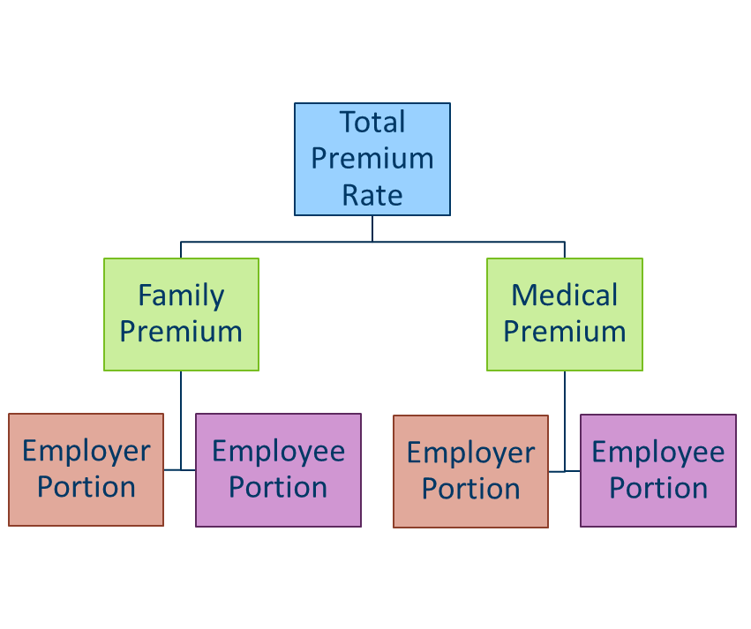
Funding the Program
Starting January 2026, Paid Leave premiums will be financed through payroll deductions on employee wages and contributions from employers. The first premium is due April 30, 2026.
Employers can deduct up to 50% of premiums from employee paychecks, starting January 1, 2026.
Employers with 30 or fewer employees with an average employee wage of less than 150% of the statewide average annual wage are entitled to a reduced premium, ($107,016 in 2025).
Total Premium Rate
Family Premium
Employer Portion
Employee Portion
Medical Premium
Employer Portion
Employee Portion

Slide 19
Small Employer Assistance
Starting in January 2026, funding will be available to support small businesses during an employee’s absence. Leave administrators will be able to apply for this funding once an employee is approved for leave.
Qualifications:
Benefits:
30 or fewer employees
Average employee wage of under 150% of Statewide Average Annual Wage ($104,286 in 2023)
Funding up to $3,000 to
Hire temporary workers
Increase an existing workers’ wages to substitute for an employee

Slide 20
Informing Your Workforce
By December 2025, Minnesota employers must:
Hang a workforce poster in a conspicuous place in English and any language spoken by five or more employees or independent contractors.
Notify individual employees directly in their native language within 30 days of hire (or 30 days before premium collection begins).
Most Minnesotans learn about their rights and benefits in the workplace.
Minnesota Paid Leave will help you be an effective and enthusiastic messenger to your employees so you can benefit from the improved retention, productivity, and morale Paid Leave brings.
Minnesota Paid Leave will create the poster and a model notification letter and make them available in multiple languages on our website.
By December 2025, Minnesota employers must:
Most Minnesotans learn about their rights and benefits in the workplace.
Minnesota Paid Leave will help you be an effective and enthusiastic messenger to your employees so you can benefit from the improved retention, productivity, and morale Paid Leave brings.
Minnesota Paid Leave will create the poster and a model notification letter and make them available in multiple languages on our website.
Hang a workforce poster
Notify individual employees
in a conspicuous place in English and any language spoken by five or more employees or independent contractors.
directly in their native language within 30 days of hire (or 30 days before premium collection begins).
paidleave.mn.gov

Slide 21
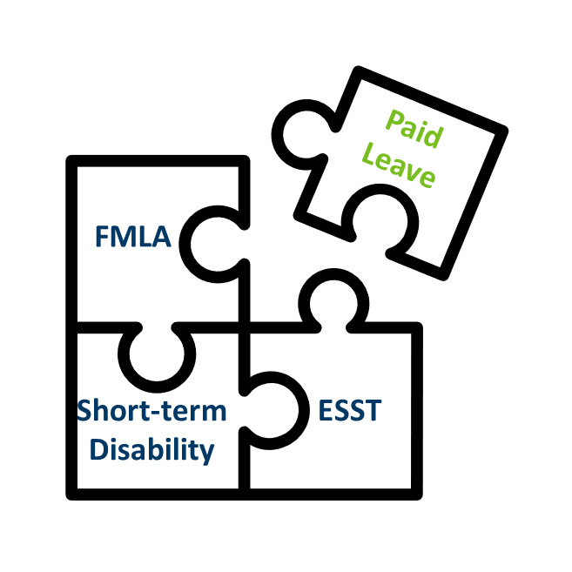
Coordinating Benefits and Leave
Paid Leave fits into a bigger picture for workers and employers, as many already offer various leave benefits to employees.
As a trusted messenger to your workers and with your experience in the workplace, employers will play an important role coordinating Paid Leave and other benefits.
Minnesota Paid Leave is partnering with employers and communities to deliver solutions that make Paid Leave work for all Minnesotans.
Your partnership and support for Paid Leave allows employees to take the time they need to care, builds connections in our communities and workplaces, and improves retention, productivity, and morale on the job.

Slide 22
Help Make Paid Leave Work
Your partnership and experience help make Paid Leave work.
Check out FAQs on our website: paidleave.mn.gov
Register for a UI account: uimn.org/employers/
Sign up for the Paid Leave updates: Minnesota Paid Leave Newsletter
Send us questions: Paid Family and Medical Leave Question Form
Watch for upcoming opportunities to engage and provide feedback on program and product design

Slide 23
Thank you + Questions
Betsy Ohrn | Minnesota Paid Leave

